Slide 1
AWS Signup And Login

Slide 2
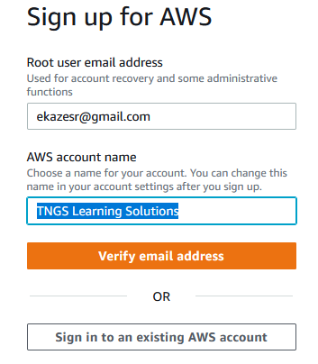
AWS signup step by step process
Click on the URL below to open AWS signup or login landing page.
https://portal.aws.amazon.com/billing/signup#/start/email
Enter the following;
Root user email address
AWS account
Click on Verify email address

Slide 3
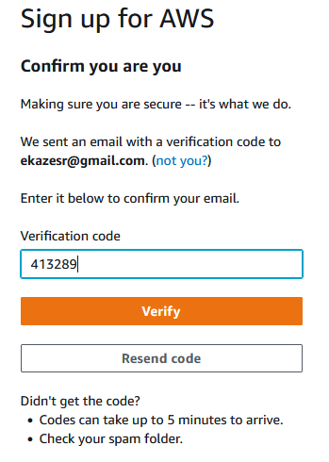
AWS signup step by step process
Enter the verification code sent to you email address.
Click on Verify

Slide 4
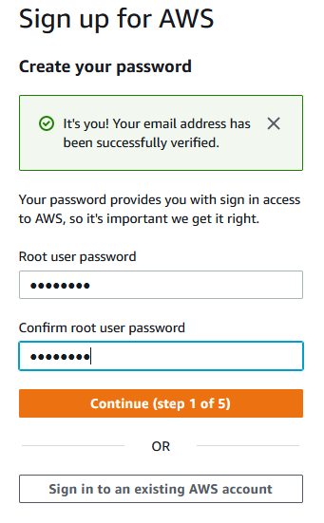
AWS signup step by step process
Enter;
Root user password
Confirm root user password
Click on Continue (step 1 of 5)

Slide 5
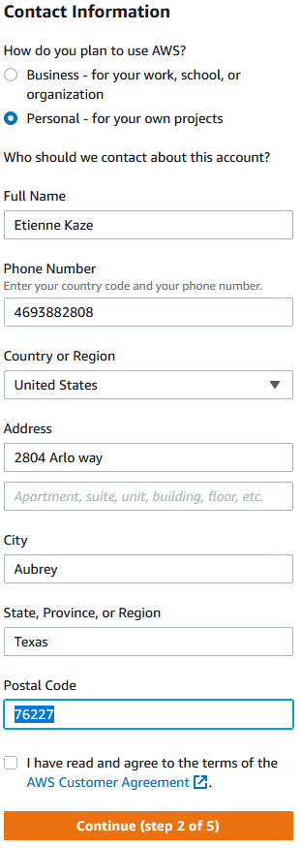
Select;
Personal
Enter the following;
Full name
Phone number
Country or region
Address
City
State
Postal Code
Select I have read and agree to the terms of the AWS Customer Agreement.
Click on Continue (step 2 of 5)

Slide 6
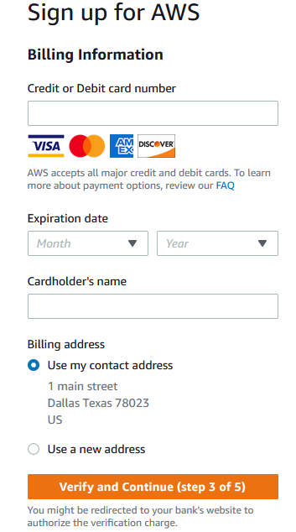
Enter Billing Information
Credit or Debit card number
Expiration date
Cardholder's name
Billing address
Click on Verify and Continue

Slide 7
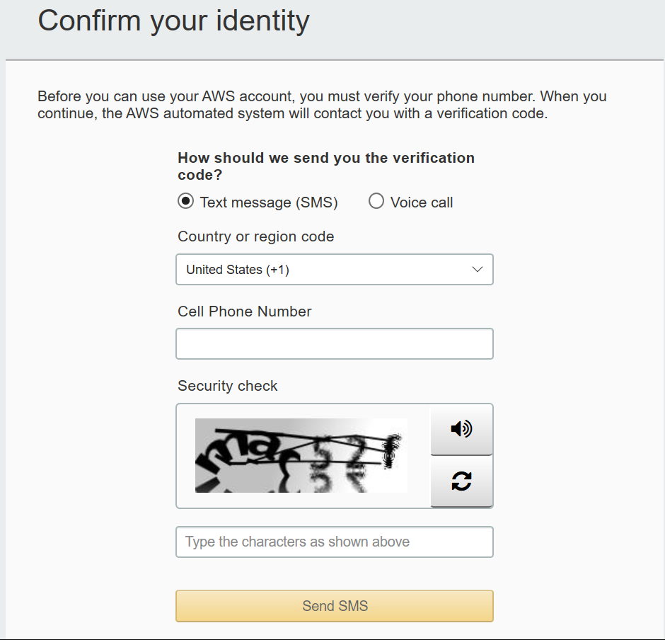
Enter;
Cell Phone Number
Security Check

Slide 8
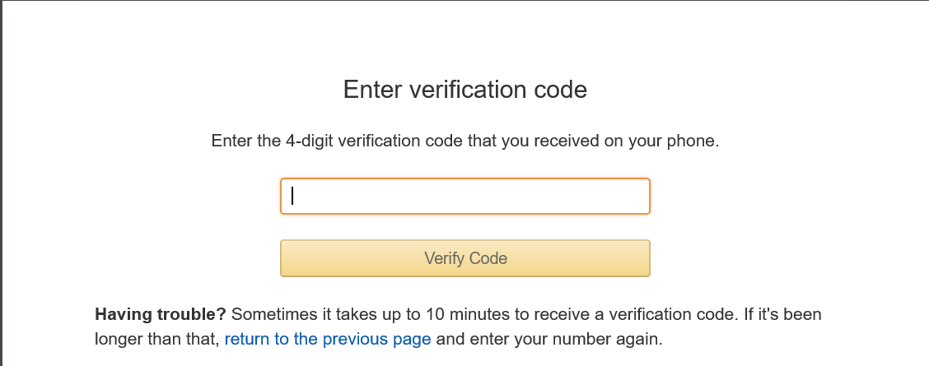
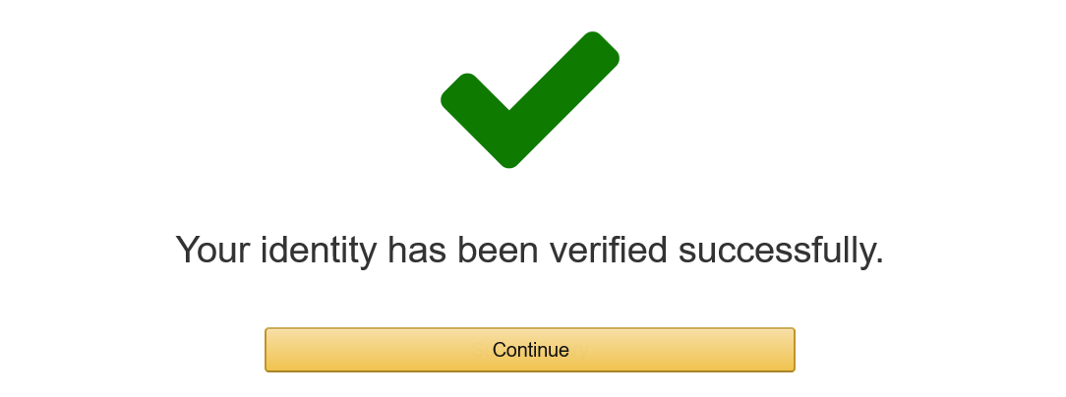
Once completed successfully, you will get a confirmation like this.

Slide 9
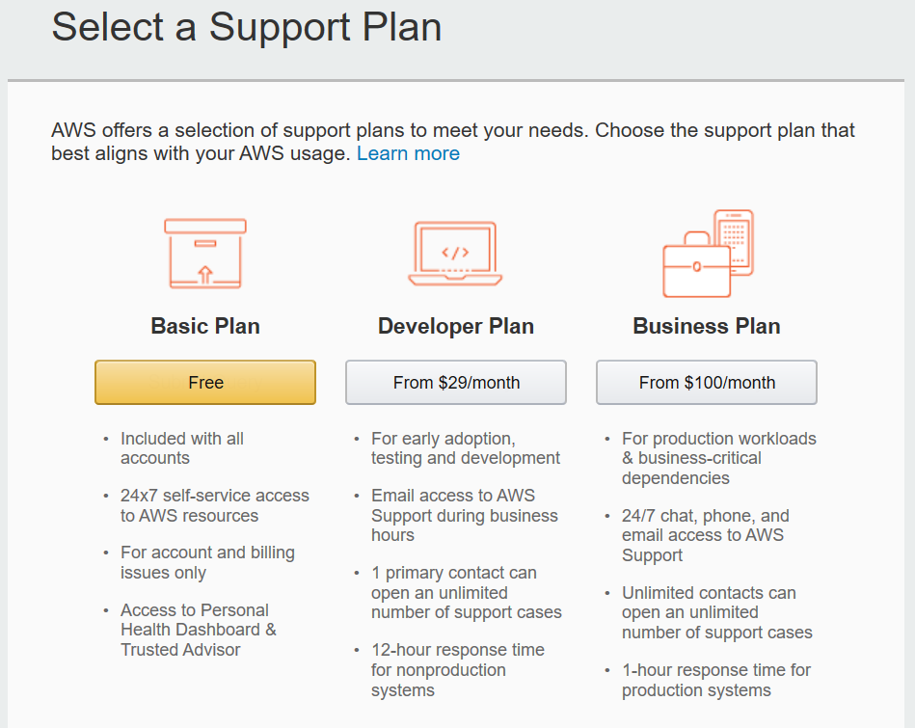
Next, select the support plan as Basic Plan which is free.
You can find the more information on the below link regarding the support plans and its features
https://aws.amazon.com/premiumsupport/plans/

Slide 10
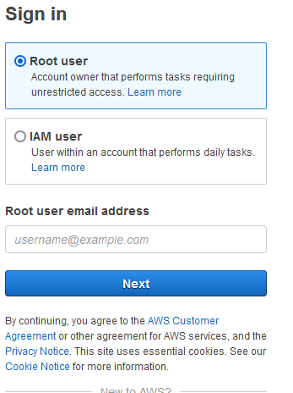
Navigate to the AWS Login Page
Select Root user
Enter Root user email address (email id used to sign up)
click on Next.

Slide 11
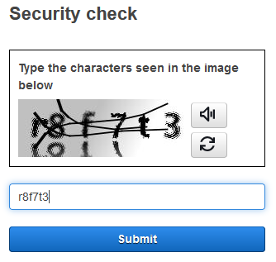
Type the characters seen in the image below

Slide 12
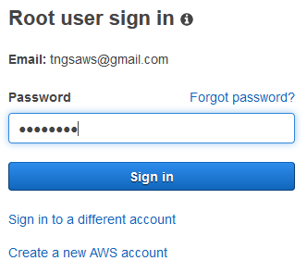
Enter password
click on sign in to log into the AWS Management console.

Slide 13
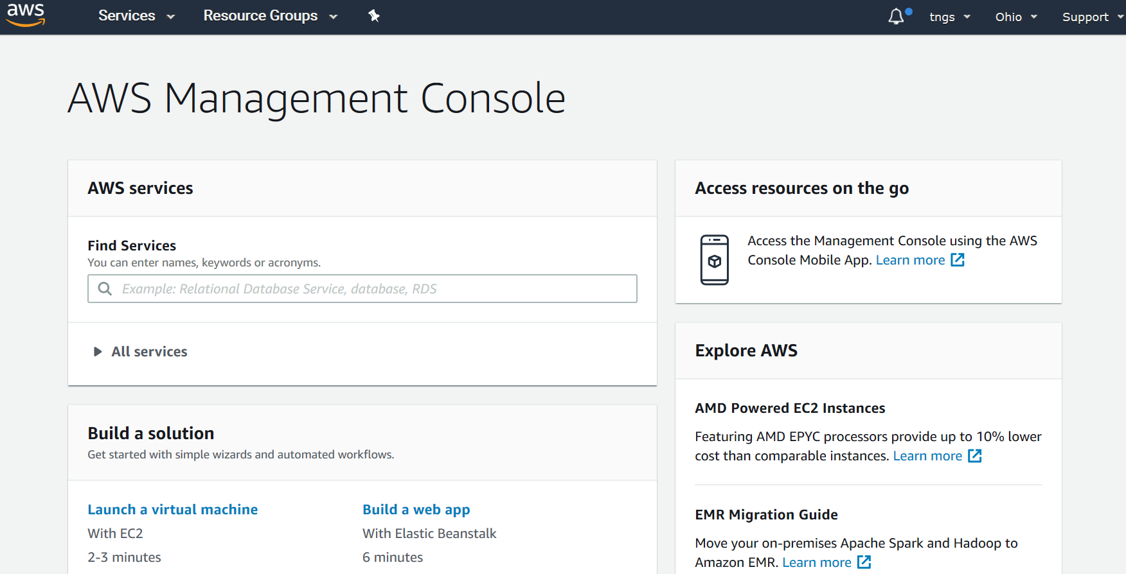
Once signed in you will get in to AWS console look like above.

